Slide 1
Optimización multiobjetivo en cancer de mama utilizando COBRA Toolbox

Slide 2
multiobjective optimality
Hypothesize that cancer metabolism is driven by these trade-offs, Cancer cells optimize their metabolism by balancing competing biological objectives
Biomass maximization
maximization of atp production
minimization of total abundance of metabolic enzymes
minimization of total carbon uptake
total abundance of intracellular proteins is limited by molecular crowding in the cytoplasm
Efficiency strategies
inability to simultaneously improve performances on all objectives
Pareto Optimality

Slide 3

The carbon uptake (CU) flux:
n is number of fluxes in the model, is the number of carbon atoms imported into intracellular compartments by the i-th flux and is its flux rate. If this flux does not lead to any carbon uptake, the value of is zero.

Slide 4

Enzyme abundance (EA):
Since the coefficients have already been evaluated in the curated model in an artificial flux corresponding to the solvent capacity constraint, these values were directly utilized in our analysis.

Slide 5

Multiobjective optimization problem on a genome scale
Optimization problems: e-constrained method
1- select 1 objective from n objectives, as the objective to optimize
2- remaining N-1 of the objectives are transformed into soft constraints

Slide 6
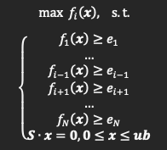
Single objective optimization
if feasible, gives a solution with Pareto optimality for the original multi-objective optimization problem
By selecting different combinations of objectives to be transformed to constraints, adjusting the ε-values (e1, …, eN), and repeatedly solving the corresponding single objective optimization problem, we can obtain a set of solutions with Pareto optimality

Slide 7
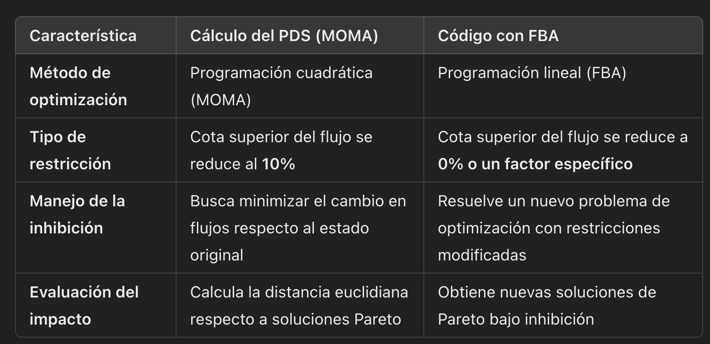

Slide 8
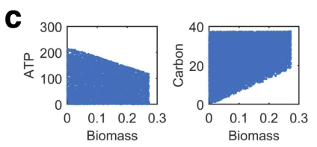
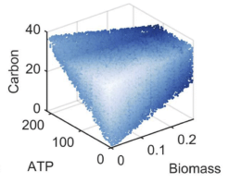
Results in article

Slide 9
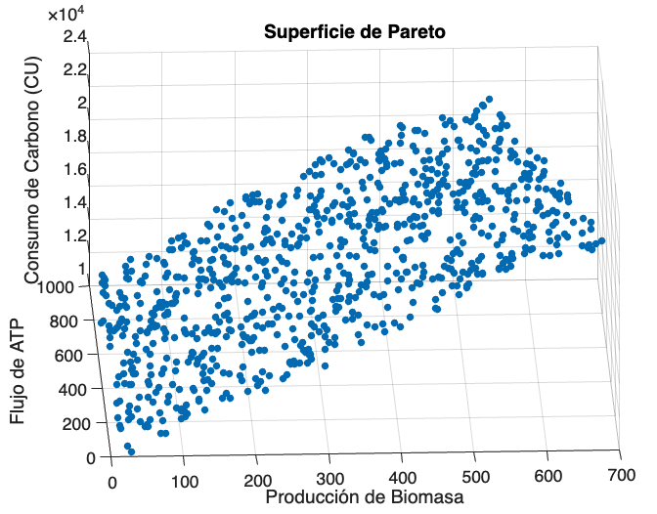
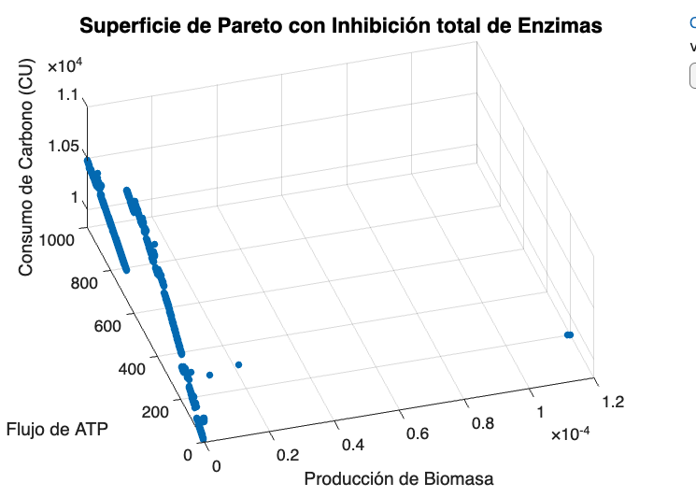
Resultados de practica

